Slide 1
Place of Contract

Slide 2
Acknowledgement
The images/ video clips in the presentation are drawn from different internet sites for the purposes of classroom instruction.
The references to the sources are at the end of the presentation.

Slide 3
Contracting parties
develop a dispute.
Which court should
they go to?

Slide 4
The Civil Procedure Code answers:
where the contract was made, or
where the contract was to be performed.

Slide 5
Applicable Law
Seller in Bangalore and buyer in London.
Which law would apply, UK or India?
as provided in the contract (express), if not,
as intended from the contract (implied), if not,
law of the place where the contract was made.

Slide 6
Where is a contract formed?

Slide 7




Slide 8

A makes an offer

Slide 9

Seconds later, B hears it.

Slide 10

B communicates acceptance. But no agreement is made as yet.

Slide 11
Seconds later, A hears it.

Slide 12
The two now are of the same mind.

Slide 13
Agreement where the offeror receives the communication of acceptance.

Slide 14
The river was the boundary of states.
Gujarat Maharashtra
The contract is made in Gujarat.

Slide 15
Commonsense:
Contract is made
where the offeror receives
the communication of acceptance.

Slide 16
The principle should apply
to all modes of communication.

Slide 17


Slide 18
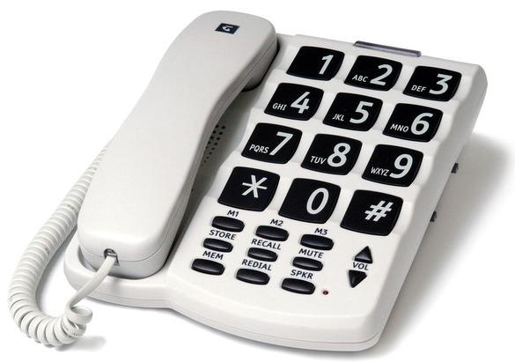

Slide 19


Slide 20


Slide 21

Video Conference

Slide 22


Slide 23
But it does not.
History has played a trick.

Slide 24
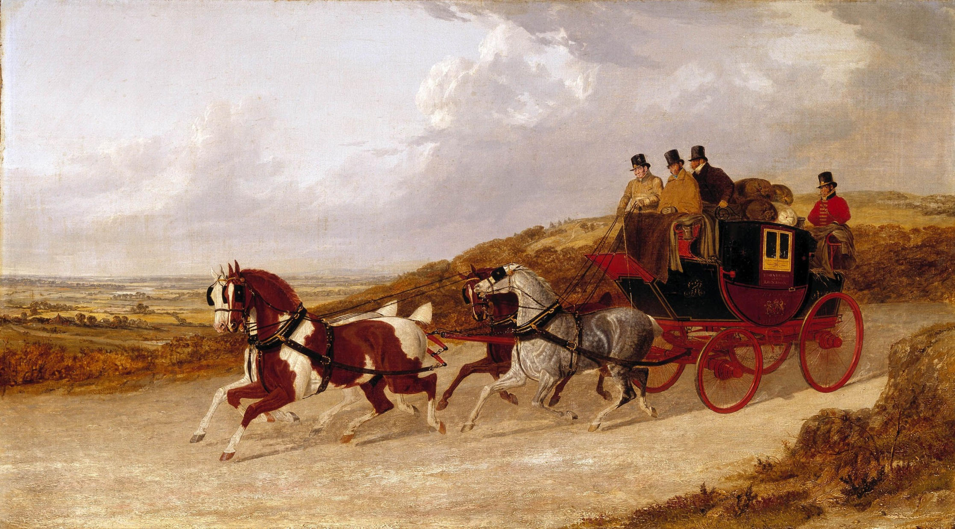
In 1700s mail service developed.
Horsemen delivered letters of their customers from one town to another.

Slide 25
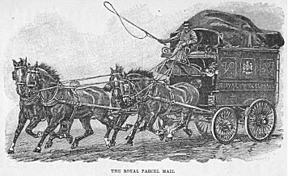
Postal Communication
posed a problem.

Slide 26
An offeror could
get out of any contract
by denying having received
the letter of acceptance.

Slide 27

Offeror
Acceptor
Acceptance
Offer
Offeror backs out and says: Letter? What letter? Which letter?

Slide 28
The mail service had become
the backbone of trade and commerce.

Slide 29
The acceptor had the proof
of having sent a letter
with a horseman and
having paid him for it.

Slide 30
For these practical reasons,
the courts made an exception that:
in communication by post,
an agreement is made where
the acceptance letter is posted.

Slide 31


Agreement, on posting of letter.
Offeror
Acceptor
Acceptance
Offer

Slide 32
And then, new modes
of communication developed.

Slide 33
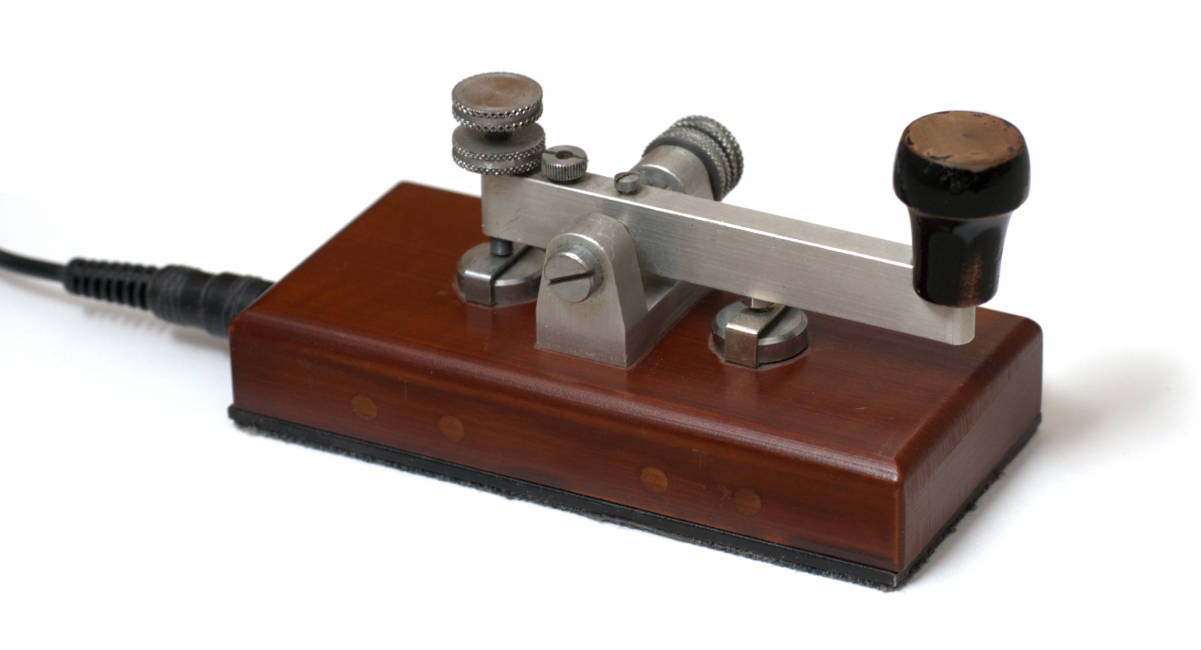

Slide 34


Slide 35
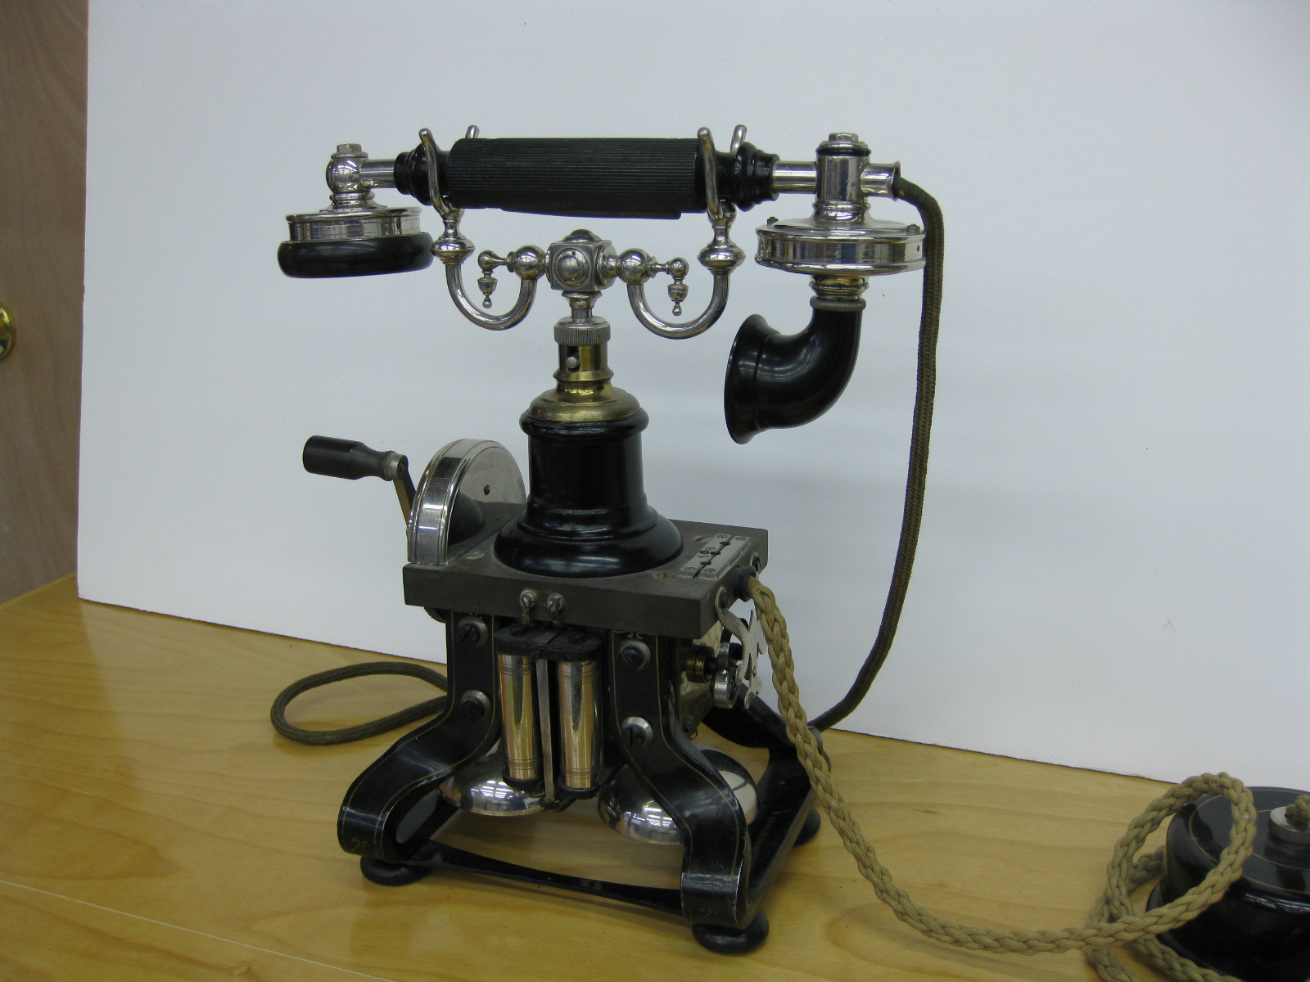

Slide 36
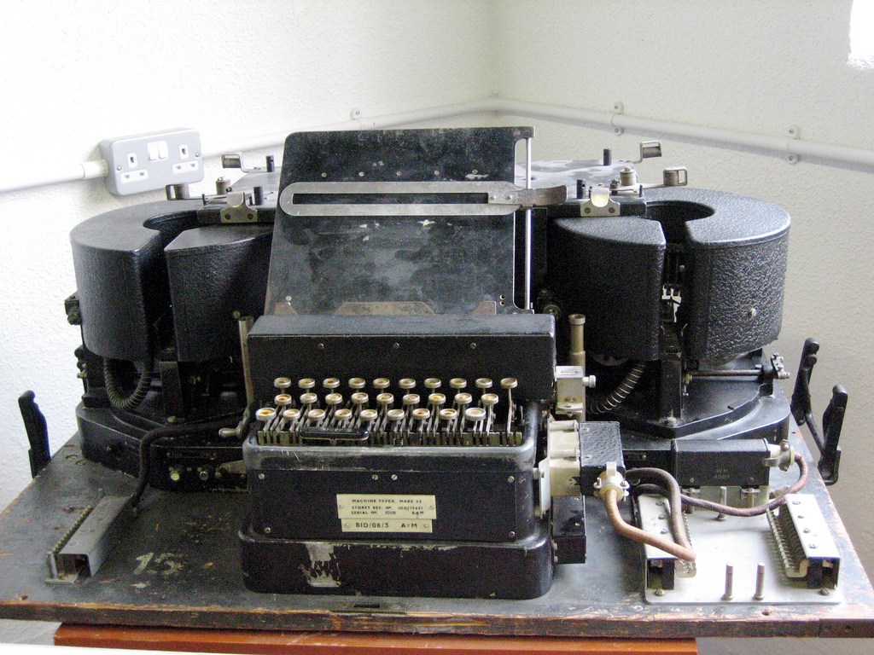
Telex

Slide 37
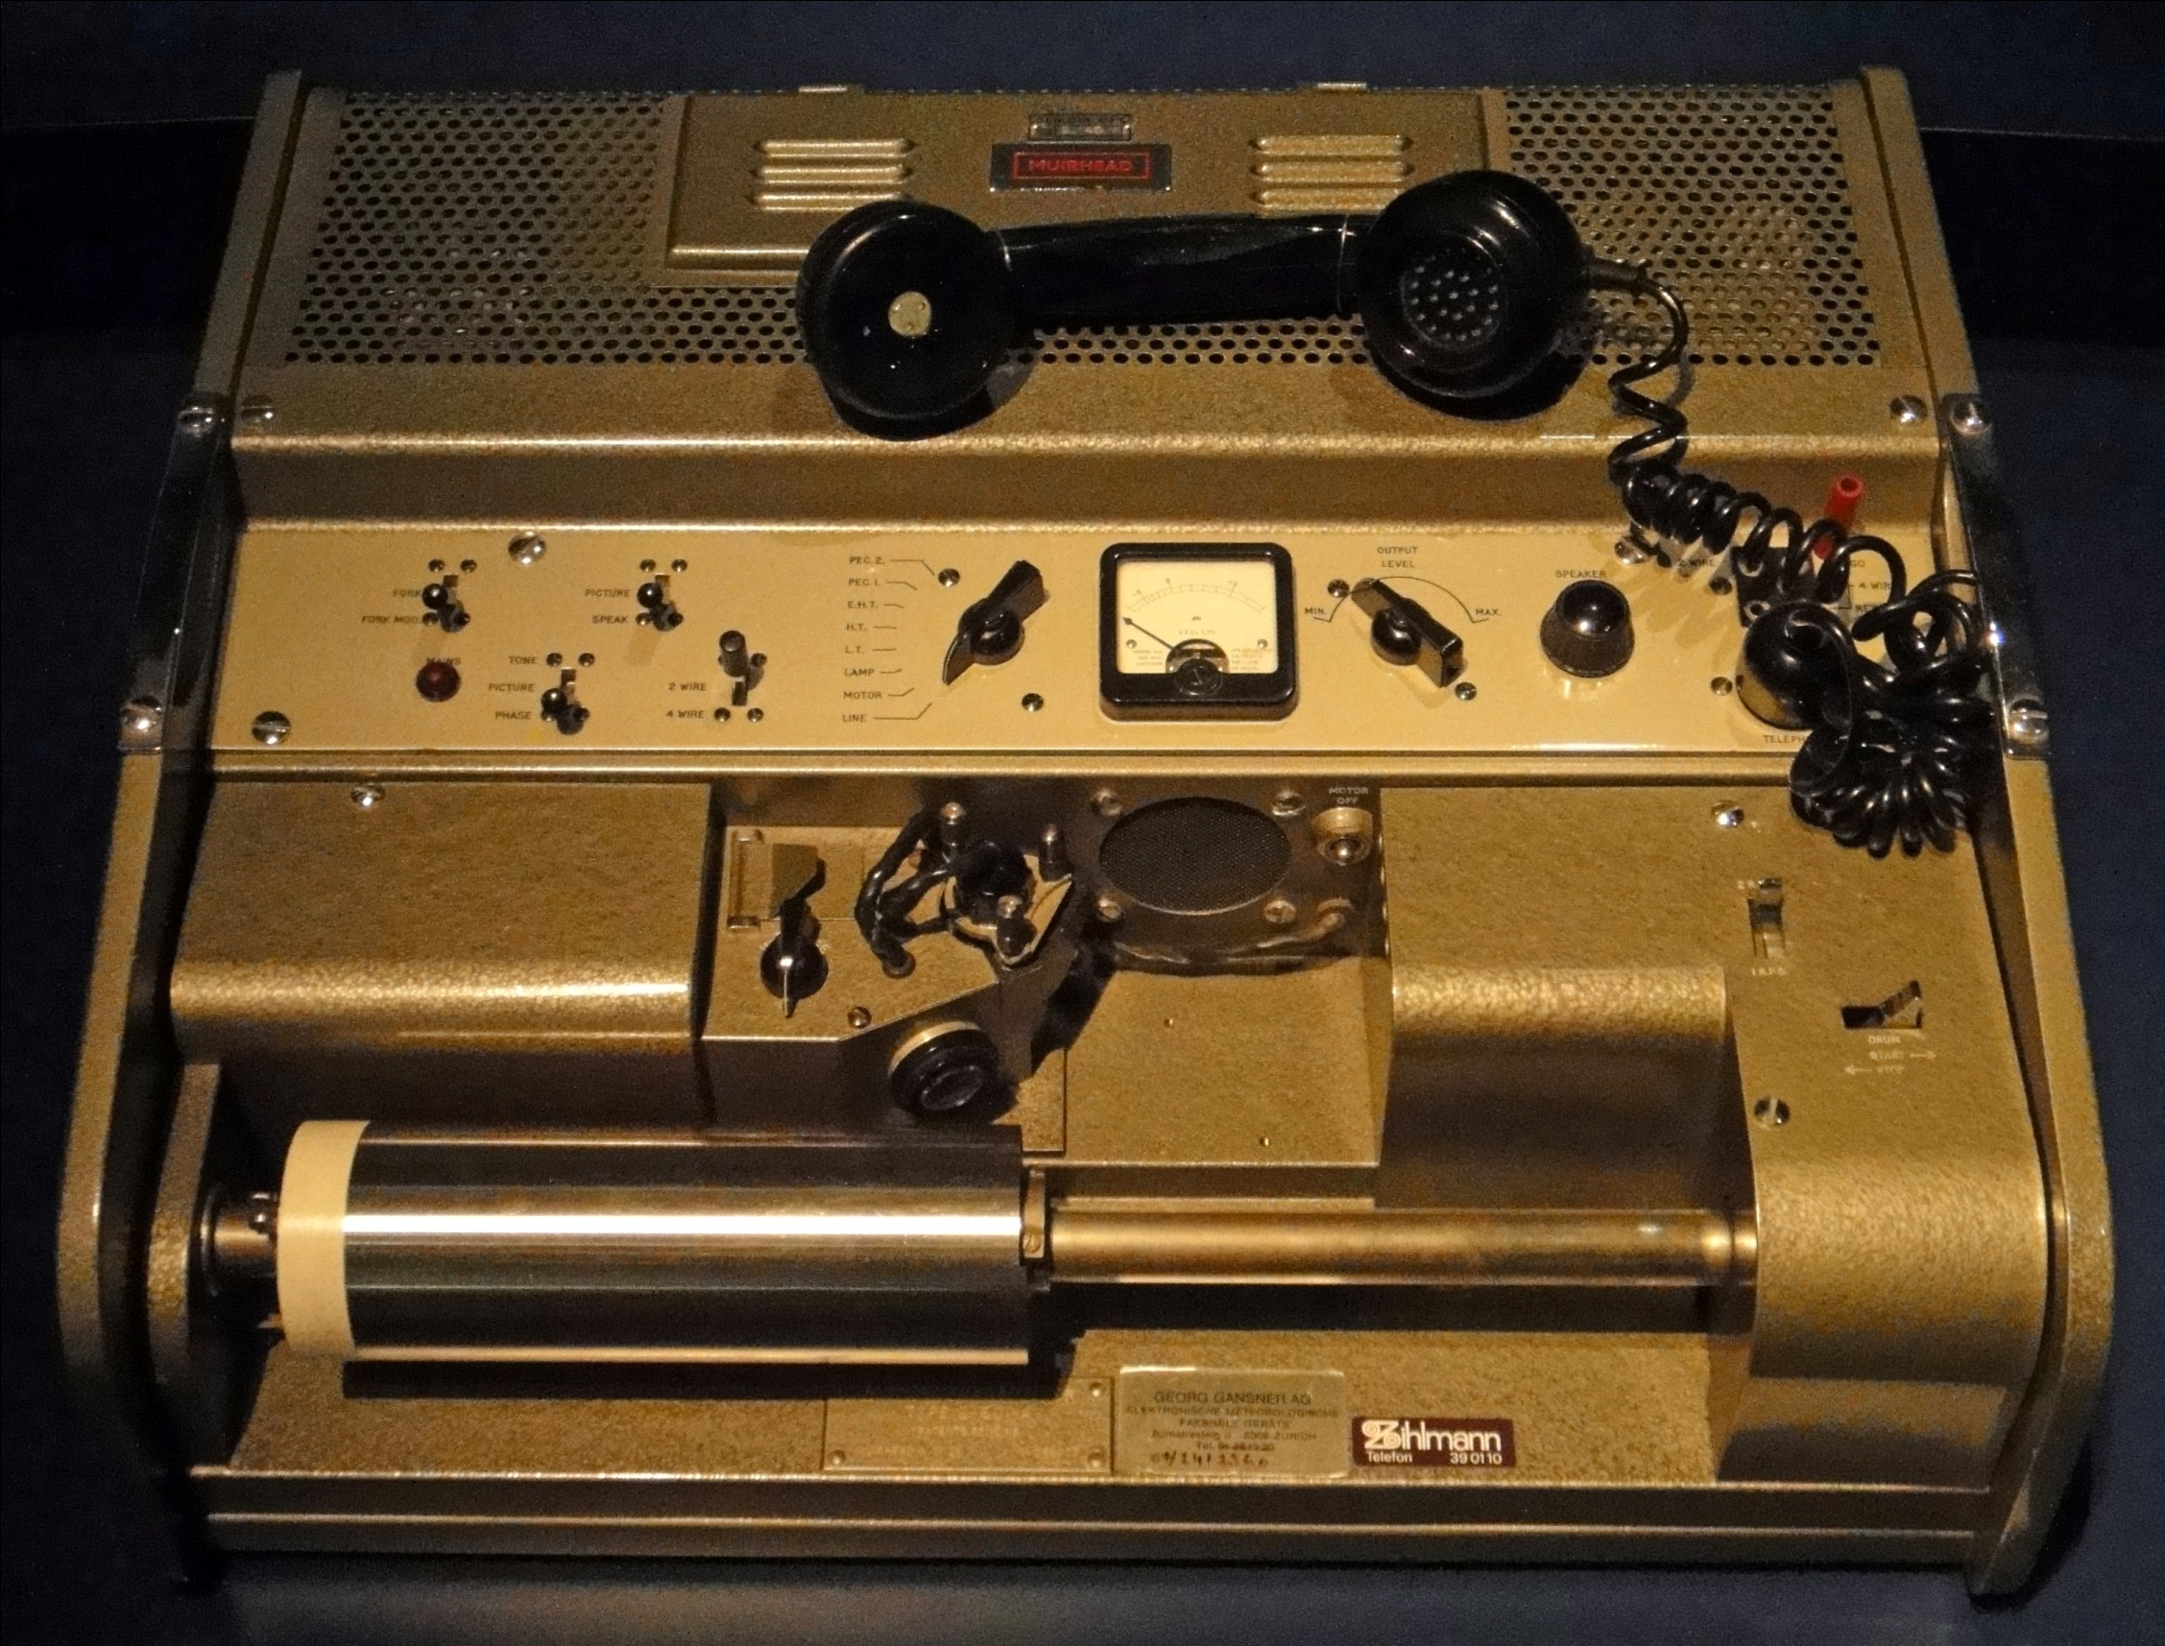
Fax

Slide 38
Extension of the law
The law was extended to the new modes of communication.
If the mode of communication was post like, where the communication was discrete and came and sat at the site of the other party, the postal rule applied.
If the mode of communication was spontaneous and dialogic, the standard logical rule applied.

Slide 39
Modes of Communication
Spontaneous and Dialogic
Discrete and post like
Logical Rule
Postal Rule

Slide 40
Decide the rule for
each mode of communication.

Slide 41


Slide 42


Slide 45
Video Conference

Slide 46
Logical or Postal Rule?
Telephone Conversation:
Email:
SMS:
Video Conference:
Logical
Postal
Postal
Logical

Slide 47
Conclusion:
Vagaries of the mode of communication will decide
the jurisdiction of court
and applicable law.

Slide 48
What could
the contracting parties
do to bring certainty?

Slide 49
Introduce terms
in the contract document.

Slide 50
Terms and Conditions
1. The sender must mention the complete postal address with pincode. In addition, the telephone number of the receiver must be mentioned.
2. In the case of a consignment which is not a document, the sender will provide the description of the goods and its value.
3. The following articles will not be accepted for carriage:
4. City Express will not provide any insurance coverage for any consignments sent, even if the value of the consignment is declared by the sender or required to be declared by City Express.
5. The liability of City Express for any loss or damage to the shipment is limited to Rs. 100/- for each consignment. Further, City Express will not be responsible for any consequential losses.
6. No compensation or refund will be paid due to late delivery of this consignment”.
7. Queries on consignment should be raised within 30 days from the date dispatch of consignment.
8. Octroi, or any other tax or duty levied on the consignment shall be born by the consignor/consignee. The amount would need to be paid by the consignor/consignee immediately on demand.
9. The sender will be entirely responsible for civil and criminal consequences arising from consigning or attempting to consign any prohibited item listed under clause 3.
10. Any dispute, controversy or claim arising out of or relating to the contract shall be subject to the jurisdiction of Courts of Mumbai.

Slide 51
Terms on Amazon.in
APPLICABLE LAW: … laws of India will govern these Terms of Use and any dispute of any sort…
DISPUTES: Any dispute … shall be submitted to the exclusive jurisdiction of the courts at Delhi, India.

Slide 52
Refer Clause 30 of the General Conditions of Contract of the Gas Authority of India.
2 Reference Material- GCC My revisions, Feb, 2017.doc

Slide 53
30. Resolution of Disputes/ Arbitration
30.1 and 30.2 [Attempt amicable resolution]
30.3 Legal Construction The Contract shall be, in all respects be construed and operated as an Indian Contract and in accordance with Indian Laws … and referred to the Court of Law situated within Union Territory of New Delhi.
30.4 [Arbitration … three arbitrators in New Delhi under the Arbitration & Conciliation Act 1996]

Slide 54
References

